Slide 1








Database II
Entertainment
Group: GraphOutLoud
Atabek, Isil 2048715
Ashok Mayagappa, Prarthana 2051998 Sah, Annanya Ajay 2044007
Database 2
Master course in Computer Engineering

Slide 2
Domain
Youtube
Instagram
Entertainment
Twitter
Grammy Awards
Database 2
6

Slide 3
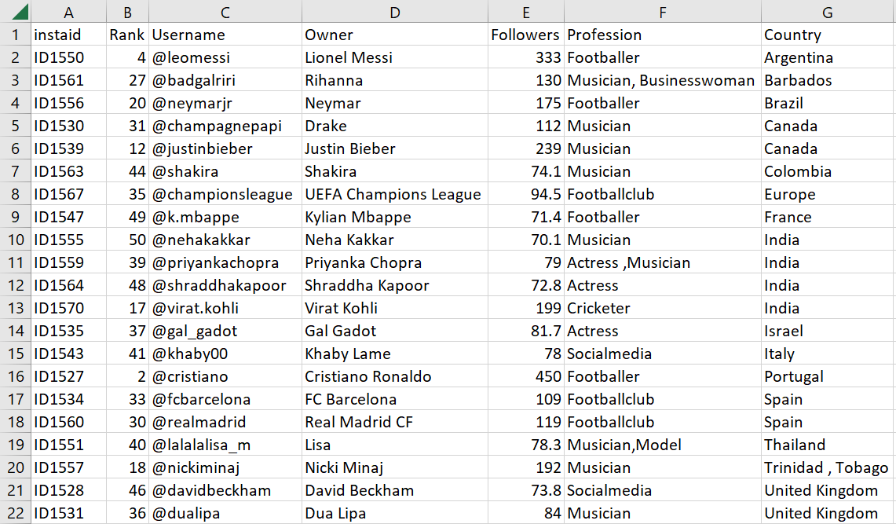
Domain
Youtube
Instagram
Top_50_Most_Followed_Instagram_Accounts
Entertainment
Twitter
Grammy Awards
Database 2
6

Slide 4
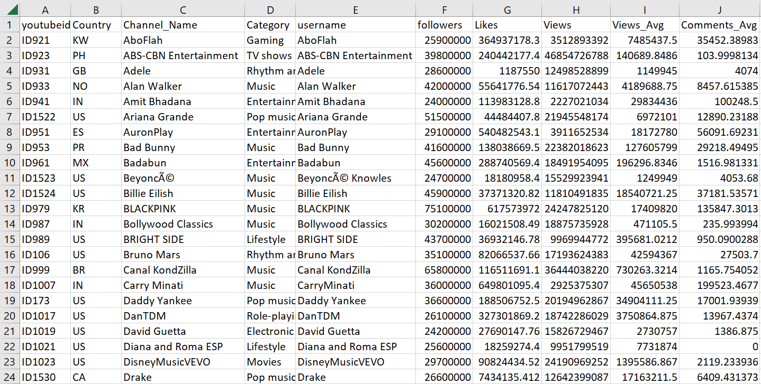
Domain
Top_200_youtubers
Youtube
Instagram
Top_50_Most_Followed_Instagram_Accounts
Entertainment
Twitter
Grammy Awards
Database 2
6

Slide 5
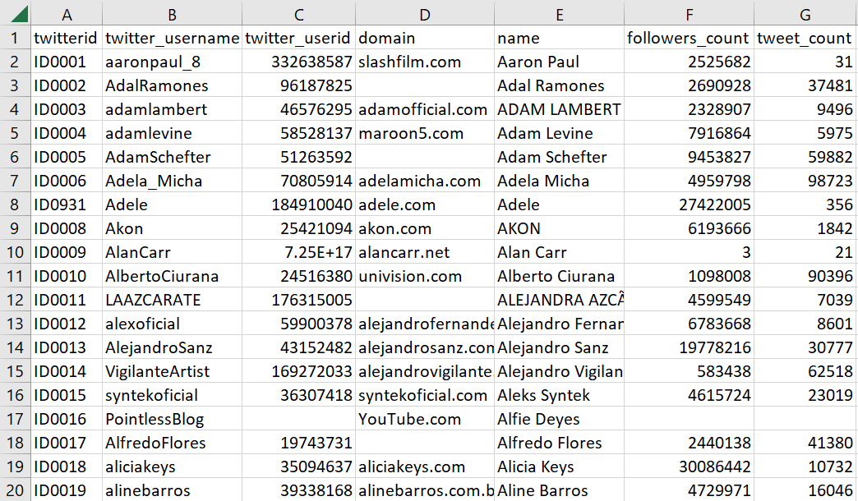
Domain
Top_200_youtubers
Youtube
Instagram
Top_50_Most_Followed_Instagram_Accounts
Entertainment
Twitter
Top_1000_Celebrity_Twitter_Accounts
Grammy Awards
Database 2
6

Slide 6
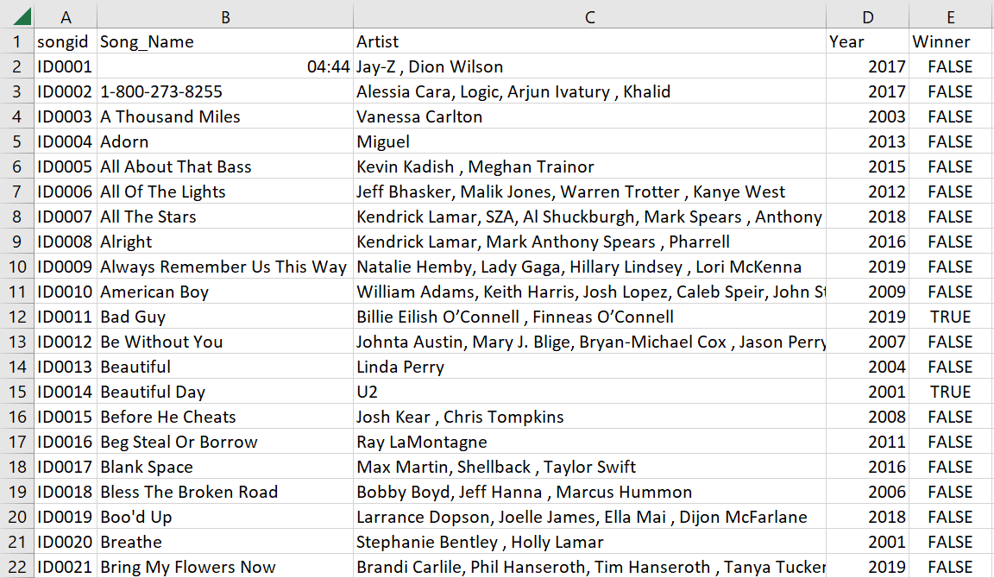
Domain
Top_200_youtubers
Youtube
Instagram
Top_50_Most_Followed_Instagram_Accounts
Entertainment
Twitter
Top_1000_Celebrity_Twitter_Accounts
Grammy Awards
Grammy_Award
Database 2
6

Slide 7
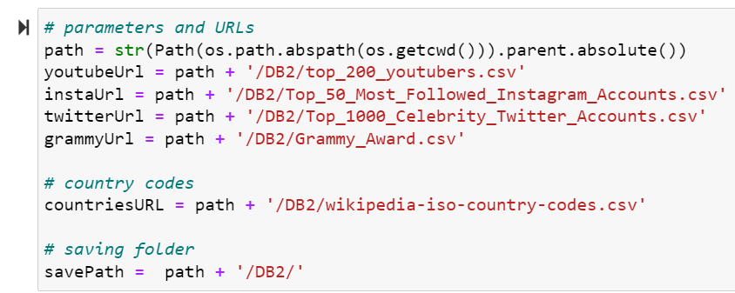
Data Cleaning and Serialisation
Database 2
6

Slide 8
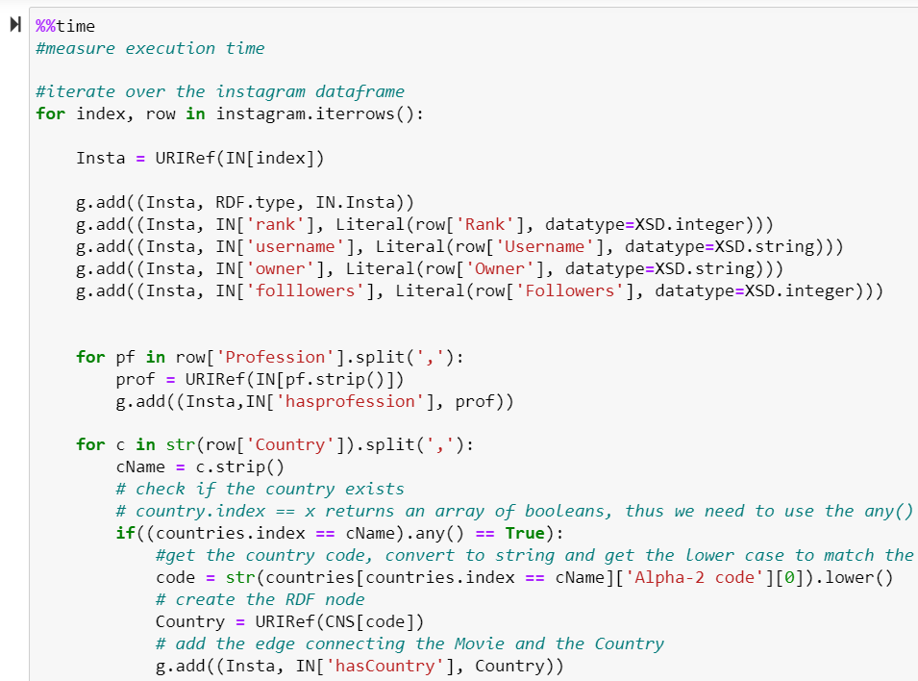
Data Cleaning and Serialisation
Database 2
6

Slide 9
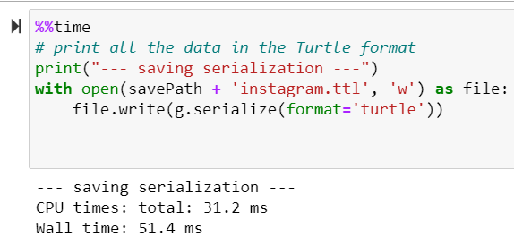
Data Cleaning and Serialisation
Database 2
6

Slide 10
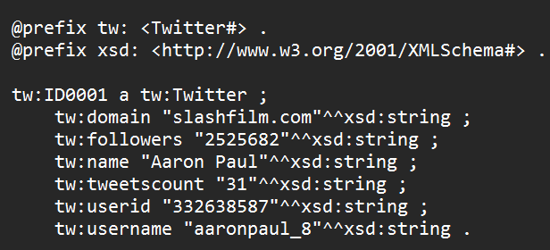
Data Cleaning and Serialisation
Database 2
6

Slide 11
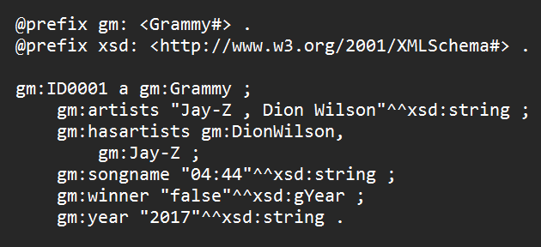
Data Cleaning and Serialisation
Database 2
6

Slide 12
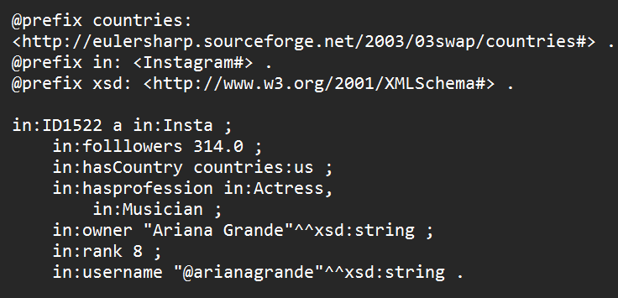
Data Cleaning and Serialisation
Database 2
6

Slide 13
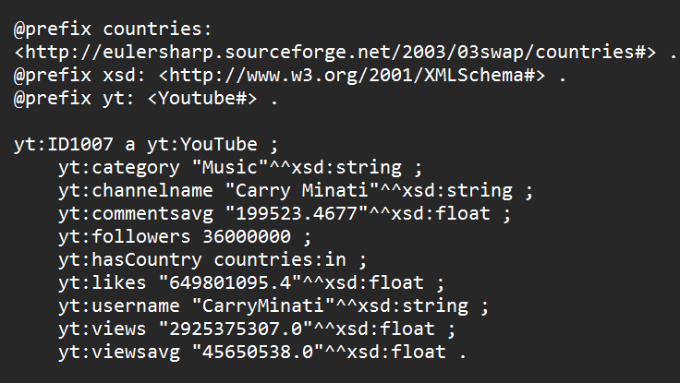
Data Cleaning and Serialisation
Database 2
6

Slide 14
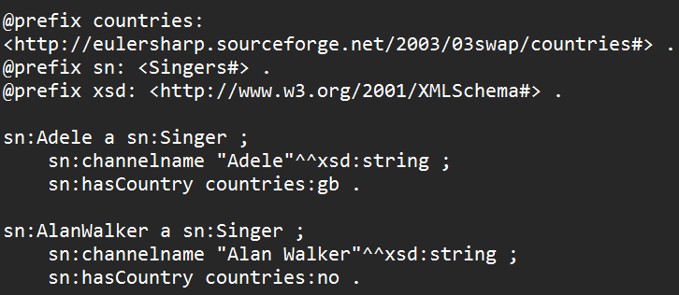
Data Cleaning and Serialisation
Database 2
6

Slide 15
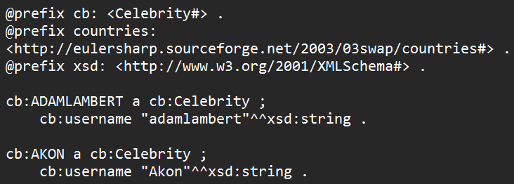
Data Cleaning and Serialisation
Database 2
6

Slide 16
Ontology Design
What is the domain that the ontology will cover?

Slide 17
Ontology Design
What is the domain that the ontology will cover?
Entertainment

Slide 18
Ontology Design
What is the domain that the ontology will cover?
Entertainment
For what we are going to use the ontology?

Slide 19
Ontology Design
What is the domain that the ontology will cover?
Entertainment
For what we are going to use the ontology?
To model celebrities, singers, social media accounts - music platforms, grammy awards.

Slide 20
Ontology Design
For what types of questions the information in the ontology should provide answers?

Slide 21
Ontology Design
For what types of questions the information in the ontology should provide answers?
Who are the top followed celebrities on twitter and instagram?
What is the number of followers of a given celebrity on twitter and instagram?
What is the rank of a given celebrity on instagram?
If a singer was nominated/awarded to grammy awards? And if so, on what year and to which song the award was given?
Where is a given celebrity is from?
Which celebrities have both instagram and twitter accounts?

Slide 22
Ontology Design
For what types of questions the information in the ontology should provide answers?
Who are the top followed celebrities on twitter and instagram?
What is the number of followers of a given celebrity on twitter and instagram?
What is the rank of a given celebrity on instagram?
If a singer was nominated/awarded to grammy awards? And if so, on what year and to which song the award was given?
Where is a given celebrity is from?
Which celebrities have both instagram and twitter accounts?
Who will use and maintain the ontology?

Slide 23
Ontology Design
For what types of questions the information in the ontology should provide answers?
Who are the top followed celebrities on twitter and instagram?
What is the number of followers of a given celebrity on twitter and instagram?
What is the rank of a given celebrity on instagram?
If a singer was nominated/awarded to grammy awards? And if so, on what year and to which song the award was given?
Where is a given celebrity is from?
Which celebrities have both instagram and twitter accounts?
Who will use and maintain the ontology?
Our ontology can be used by any people who are interested in our domain to analyse the relationships between the celebrities and social media accounts.

Slide 24
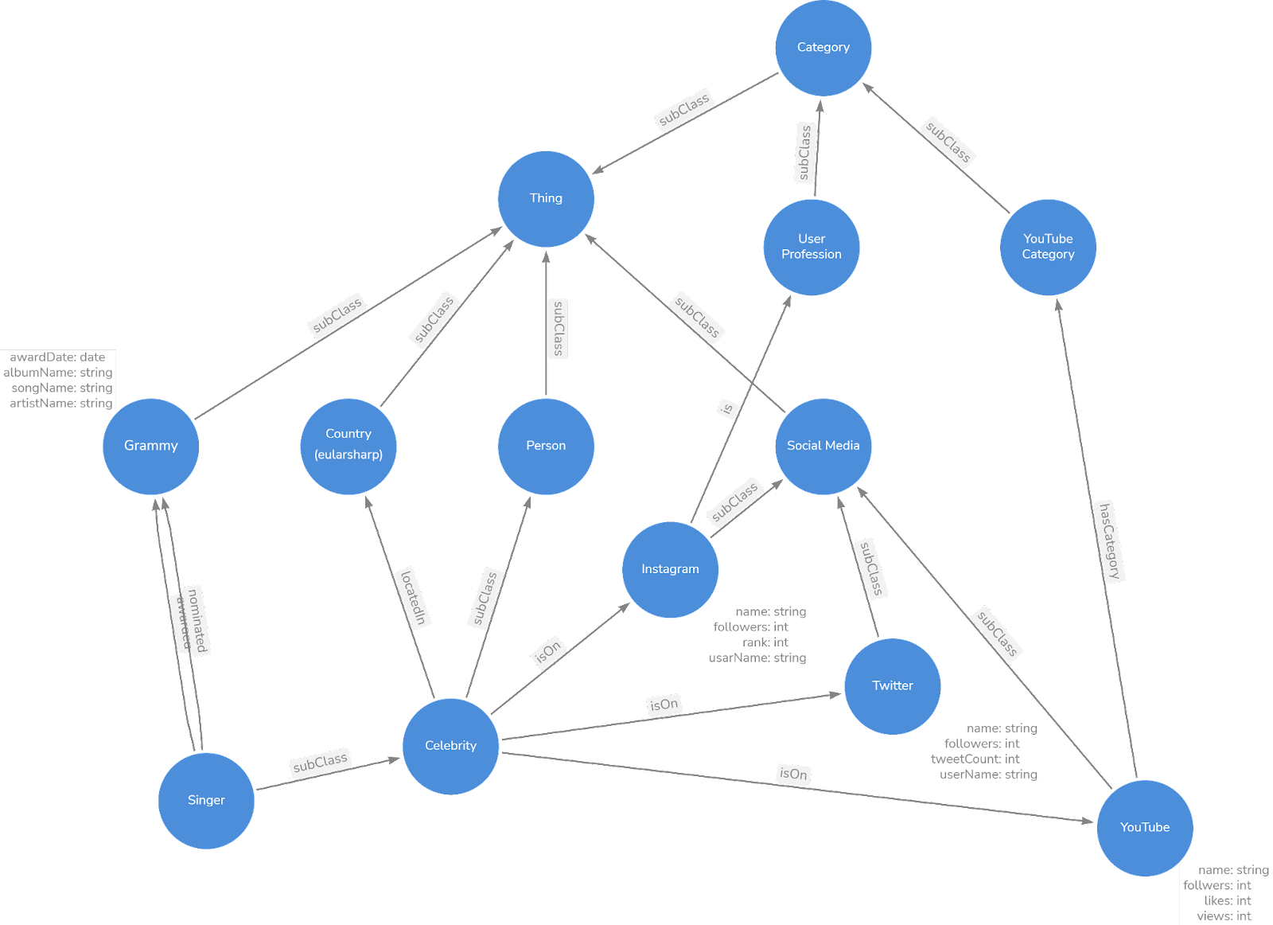
Ontology Graph

Slide 25
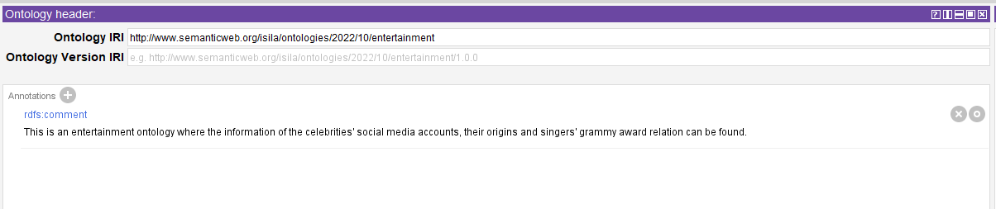
Protege

Slide 26
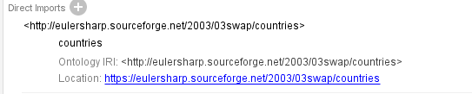
Protege

Slide 27
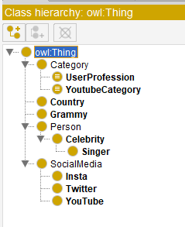
Protege - Classes

Slide 28

Protege - Classes

Slide 29

Protege - Classes

Slide 30
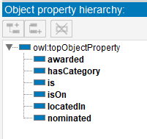
Protege - Object Properties

Slide 31
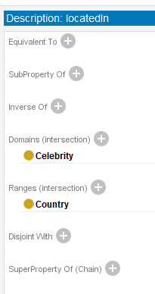
Protege - Object Properties

Slide 32
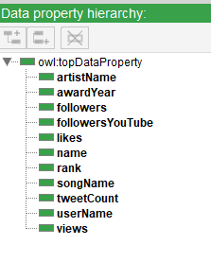
Protege - Data Properties

Slide 33
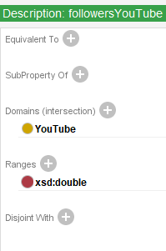
Protege - Data Properties

Slide 34
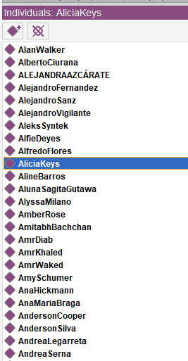
Protege - Individuals

Slide 35
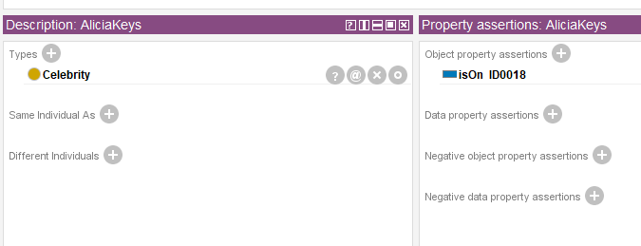
Protege - Individuals

Slide 36
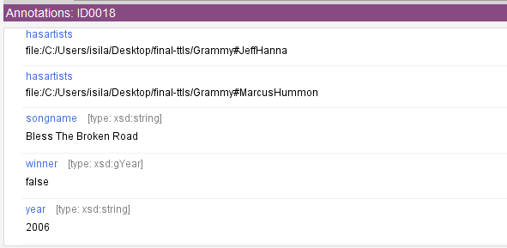
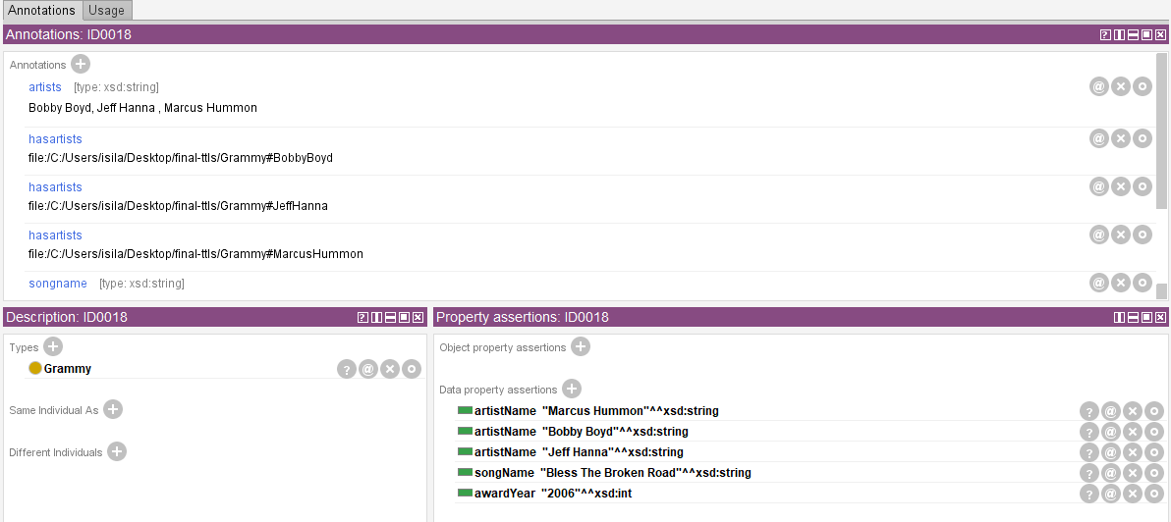
Protege - Individuals

Slide 37
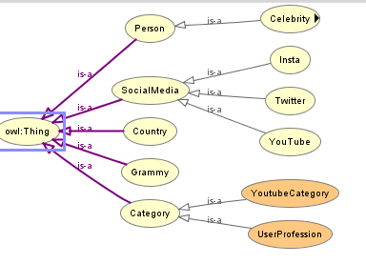
Protege - OWLViz

Slide 38
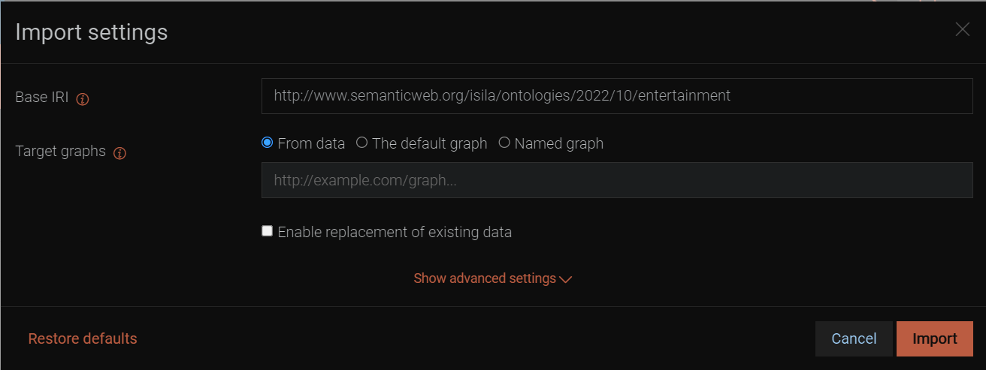
GraphDB data ingestion
Database 2
6

Slide 39
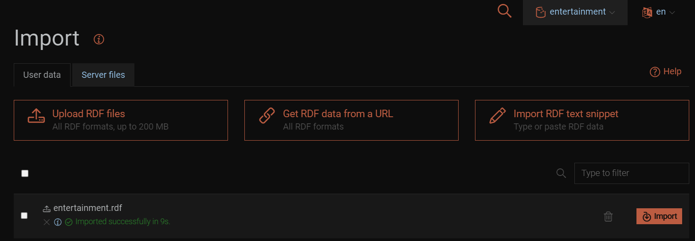
GraphDB data ingestion
Database 2
6

Slide 40
Prefixes
Gm: Grammy
Sg: Singer
Cb: Celebrity
Tw: Twitter
Ig/Insta: Instagram
Yt: Youtube
Database 2
6

Slide 41
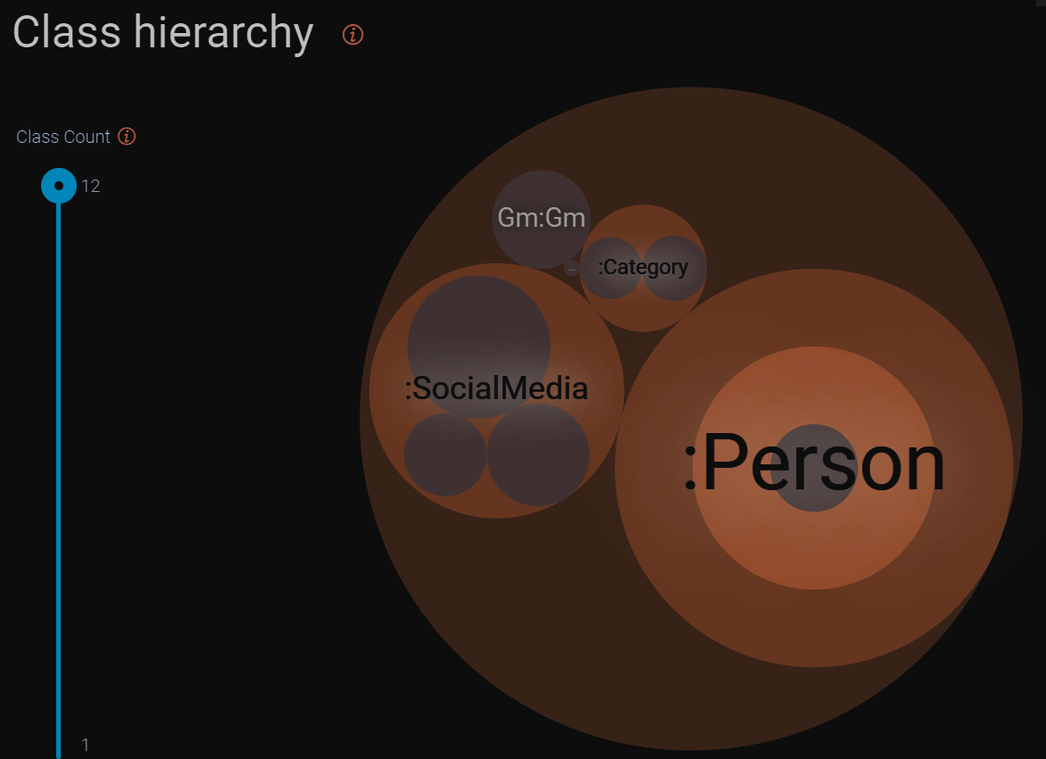
Class Hierarchy
Database 2
6

Slide 42
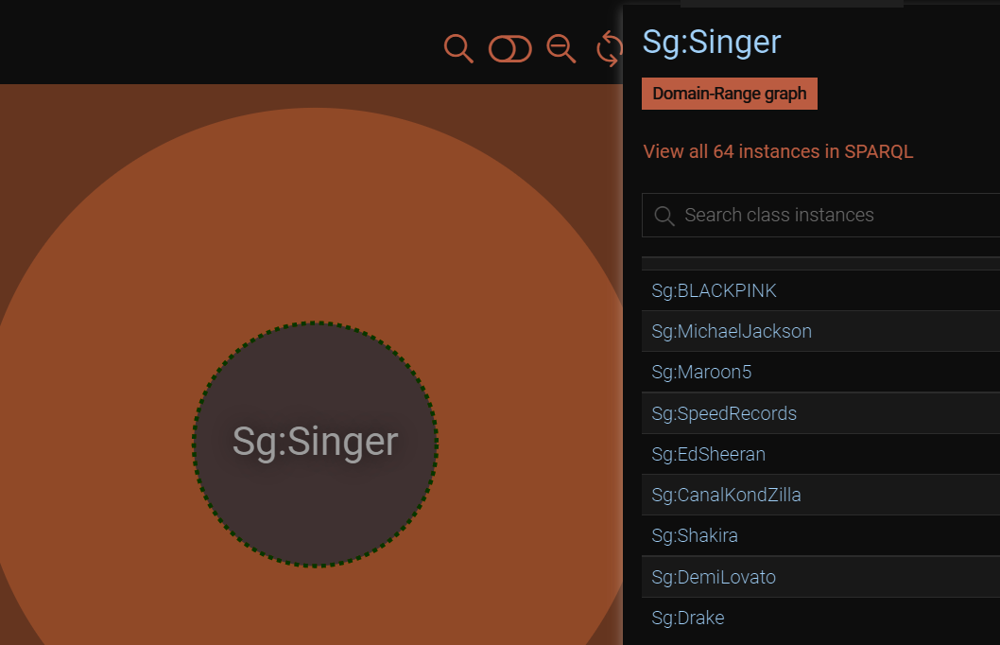
Class and Individuals
Database 2
6

Slide 43
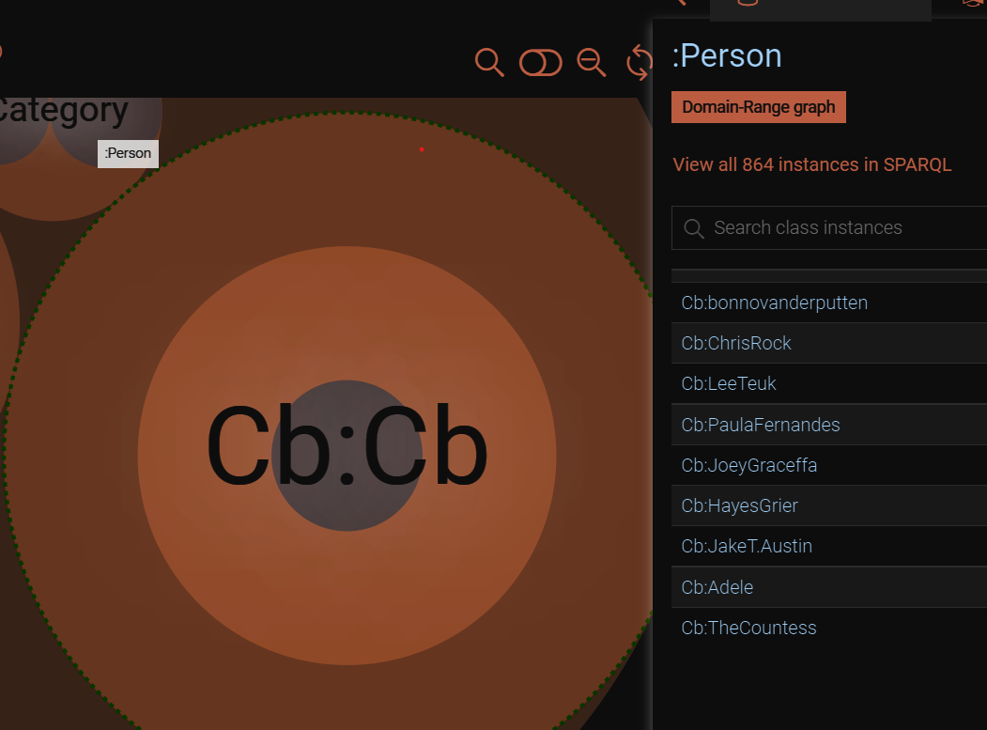
Class and Individuals
Database 2
6

Slide 44
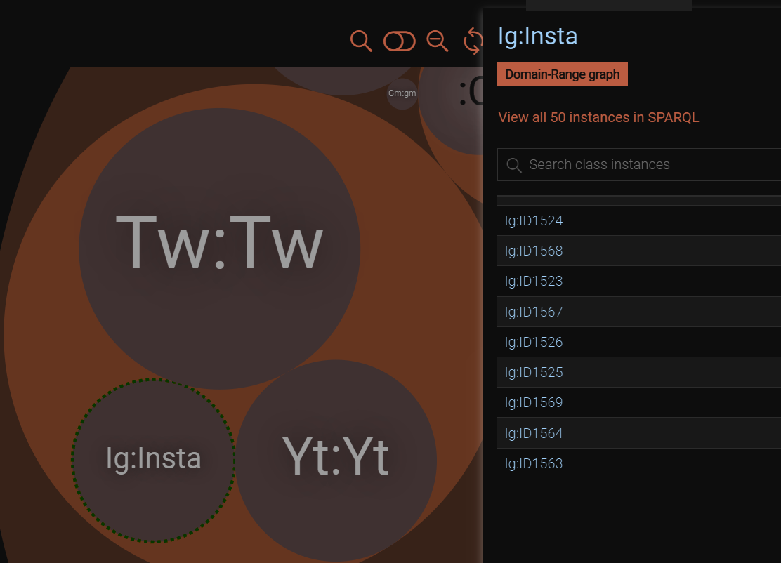
Class and Individuals
Database 2
6

Slide 45
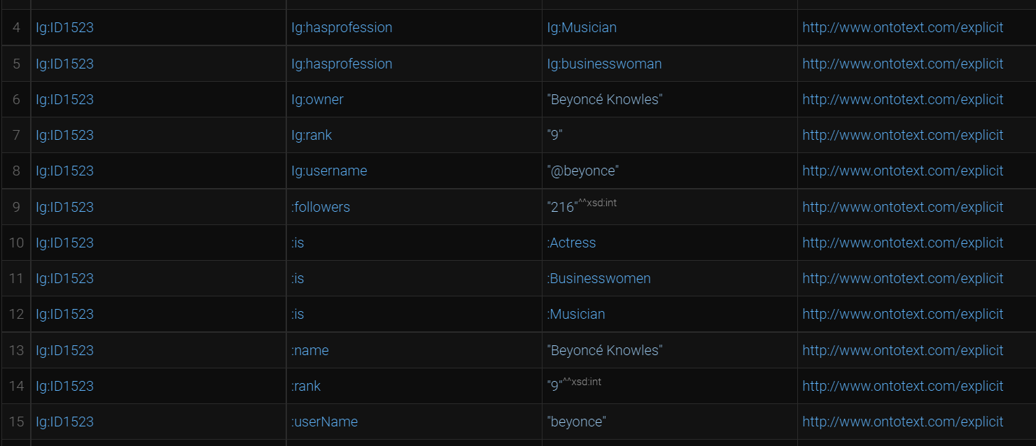
The triples
Database 2
6

Slide 46
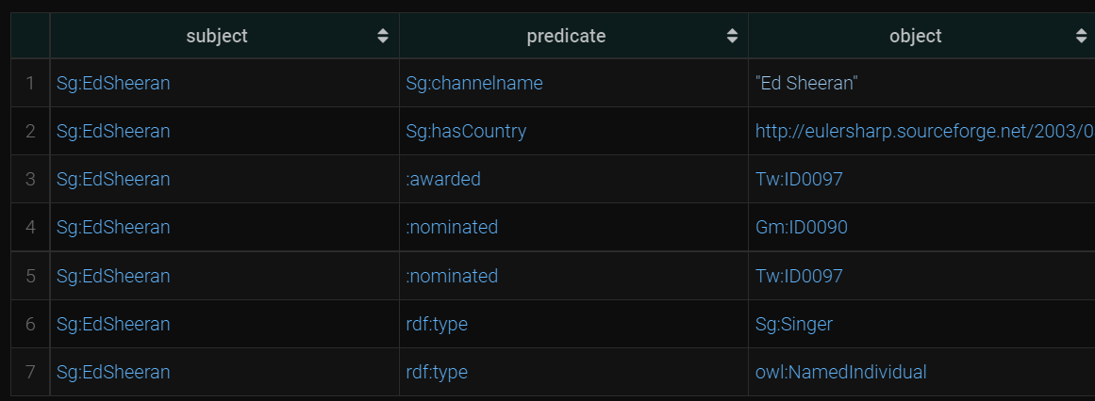
The triples
Database 2
6

Slide 47
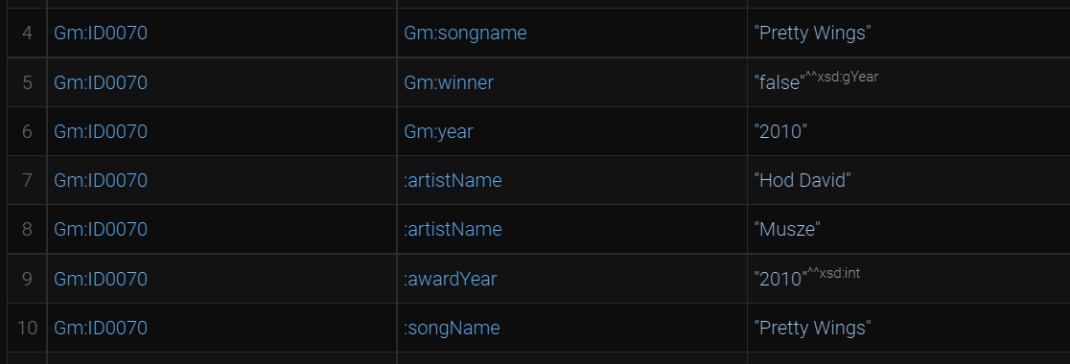
The triples
Database 2
6

Slide 48
SPARQL
1) Number of followers in order on Twitter
PREFIX xsd: <http://www.w3.org/2001/XMLSchema#>
PREFIX Tw: <file:/C:/Users/isila/Desktop/final-ttls/Tw#>
SELECT ?name ?followers
WHERE {
?s Tw:name ?name .
?s Tw:followers ?followers .
} ORDER BY DESC(xsd:integer(?followers)) LIMIT 50
Database 2
6

Slide 49
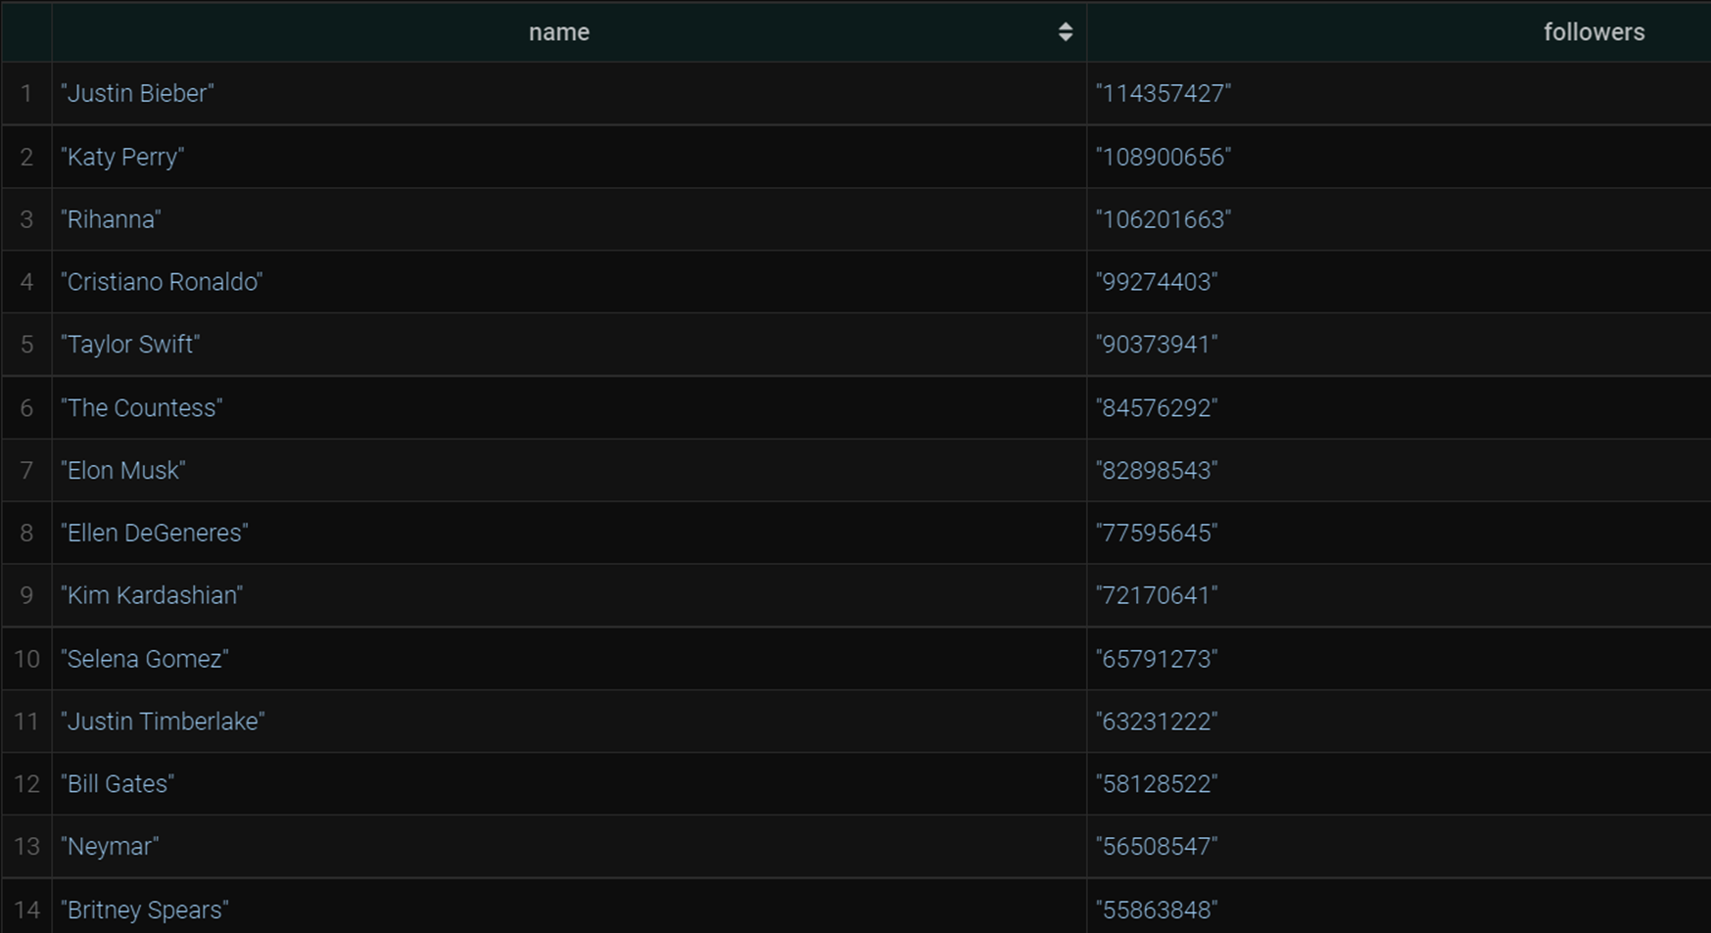
SPARQL
1) Number of followers in order on Twitter
PREFIX xsd: <http://www.w3.org/2001/XMLSchema#>
PREFIX Tw: <file:/C:/Users/isila/Desktop/final-ttls/Tw#>
SELECT ?name ?followers
WHERE {
?s Tw:name ?name .
?s Tw:followers ?followers .
} ORDER BY DESC(xsd:integer(?followers)) LIMIT 50
Database 2
6

Slide 50
SPARQL
2) Grammy winning songs from 2017 and 2019
PREFIX xsd: <http://www.w3.org/2001/XMLSchema#>
PREFIX Gm: <file:/C:/Users/isila/Desktop/final-ttls/Gm#>
select ?songname ?artists
where {
?s Gm:songname ?songname;
Gm:year ?year;
Gm:artists ?artists;
Gm:winner ?winner .
FILTER((?year="2017" || ?year="2019") && ?winner="true"^^xsd:gYear)
}
Database 2
6

Slide 51
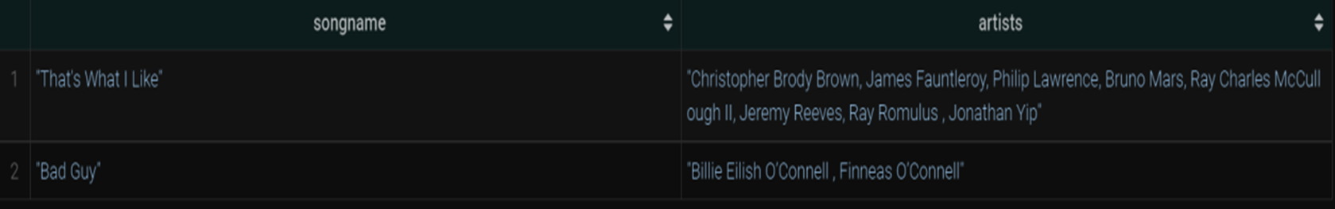
SPARQL
2) Grammy winning songs from 2017 and 2019
PREFIX xsd: <http://www.w3.org/2001/XMLSchema#>
PREFIX Gm: <file:/C:/Users/isila/Desktop/final-ttls/Gm#>
select ?songname ?artists
where {
?s Gm:songname ?songname;
Gm:year ?year;
Gm:artists ?artists;
Gm:winner ?winner .
FILTER((?year="2017" || ?year="2019") && ?winner="true"^^xsd:gYear)
}
Database 2
6

Slide 52
SPARQL
3) Rank in terms of max number of followers on Instagram
PREFIX Ig: <file:/C:/Users/isila/Desktop/final-ttls/Ig#>
PREFIX xsd: <http://www.w3.org/2001/XMLSchema#>
select DISTINCT ?owner ?rank ?followers ?profession
where {
?s Ig:owner ?owner;
Ig:rank ?rank;
Ig:folllowers ?f;
Ig:hasprofession ?profession .
BIND(CONCAT(STR( ?f ), " M") AS ?followers ) .
} ORDER BY(xsd:integer(?rank))
Database 2
6

Slide 53
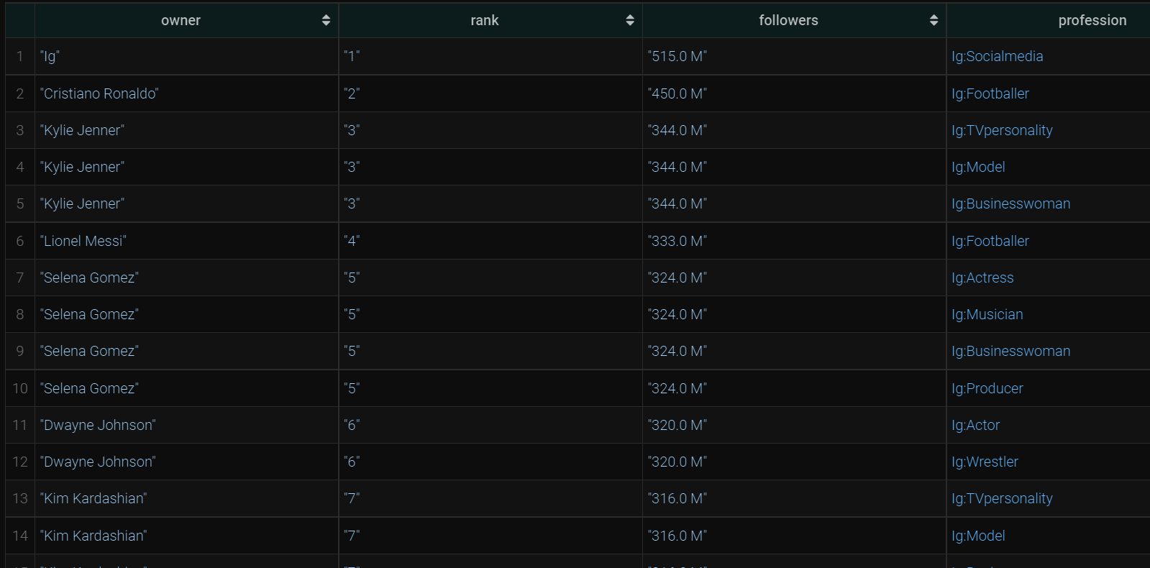
SPARQL
3) Rank in terms of max number of followers on Instagram
PREFIX Ig: <file:/C:/Users/isila/Desktop/final-ttls/Ig#>
PREFIX xsd: <http://www.w3.org/2001/XMLSchema#>
select DISTINCT ?owner ?rank ?followers ?profession
where {
?s Ig:owner ?owner;
Ig:rank ?rank;
Ig:folllowers ?f;
Ig:hasprofession ?profession .
BIND(CONCAT(STR( ?f ), " M") AS ?followers ) .
} ORDER BY(xsd:integer(?rank))
Database 2
6

Slide 54
SPARQL
4) List of categories of Youtube channels by order
PREFIX xsd: <http://www.w3.org/2001/XMLSchema#>
PREFIX : <http://www.semanticweb.org/isila/ontologies/2022/10/untitled-ontology-26#>
PREFIX Yt: <file:/C:/Users/isila/Desktop/final-ttls/Yt#>
select ?category ?channelName ?followers
where {
?s Yt:category ?category;
Yt:channelname ?channelName; Yt:followers ?followers .
FILTER(?category= "Music" || ?category="Hip hop music")
} ORDER BY(?channelName)
Database 2
6

Slide 55
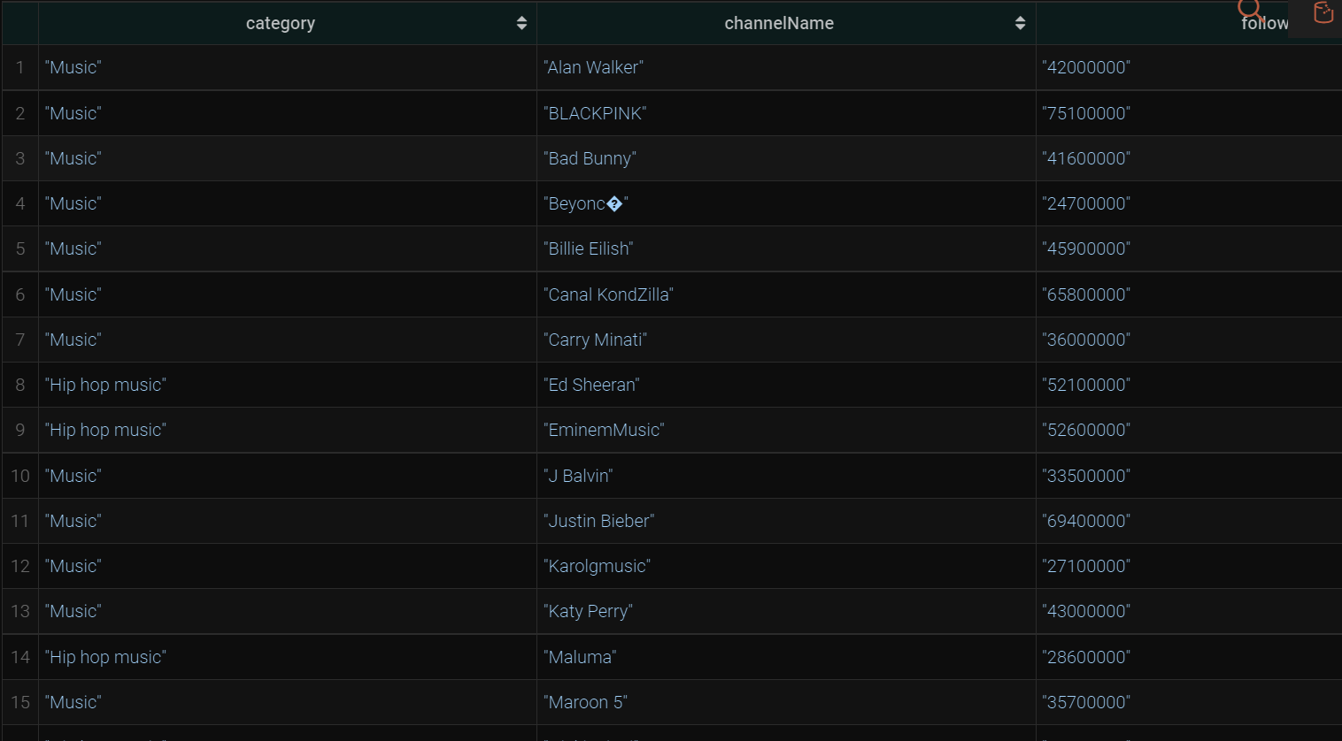
SPARQL
4) List of categories of Youtube channels by order
PREFIX xsd: <http://www.w3.org/2001/XMLSchema#>
PREFIX : <http://www.semanticweb.org/isila/ontologies/2022/10/untitled-ontology-26#>
PREFIX Yt: <file:/C:/Users/isila/Desktop/final-ttls/Yt#>
select ?category ?channelName ?followers
where {
?s Yt:category ?category;
Yt:channelname ?channelName; Yt:followers ?followers .
FILTER(?category= "Music" || ?category="Hip hop music")
} ORDER BY(?channelName)
Database 2
6

Slide 56
SPARQL
5) Singer and his/her country of birth
PREFIX Sg: <file:/C:/Users/isila/Desktop/final-ttls/Sg#>
select ?singer ?countryName
where {
?singer Sg:hasCountry ?country .
BIND(strafter(str(?country), '#') AS ?countryName).
FILTER(str(?countryName)="gb")
}
Database 2
6

Slide 57
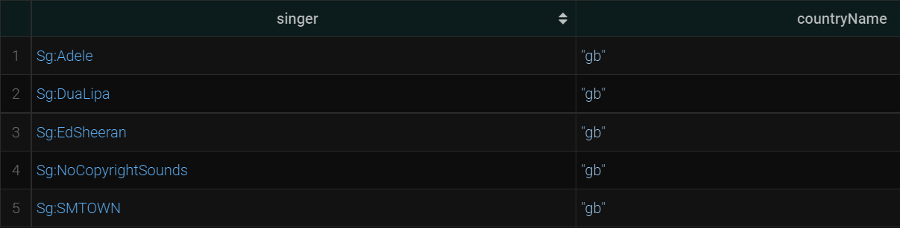
SPARQL
5) Singer and his/her country of birth
PREFIX Sg: <file:/C:/Users/isila/Desktop/final-ttls/Sg#>
select ?singer ?countryName
where {
?singer Sg:hasCountry ?country .
BIND(strafter(str(?country), '#') AS ?countryName).
FILTER(str(?countryName)="gb")
}
Database 2
6

Slide 58

SPARQL
Database 2
6

Slide 59
Thank You!
Database 2
6

